Slide 1
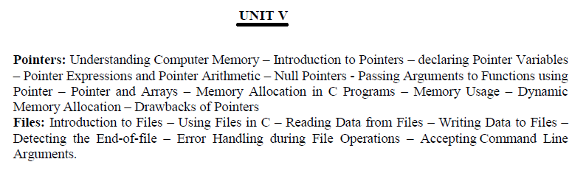

Slide 2
C free() function
“free” method in C is used to dynamically de-allocate the memory. The memory allocated using functions malloc() and calloc() is not de-allocated on their own. Hence the free() method is used, whenever the dynamic memory allocation takes place. It helps to reduce wastage of memory by freeing it.

Slide 3
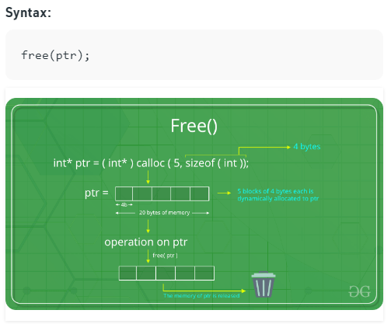

Slide 4
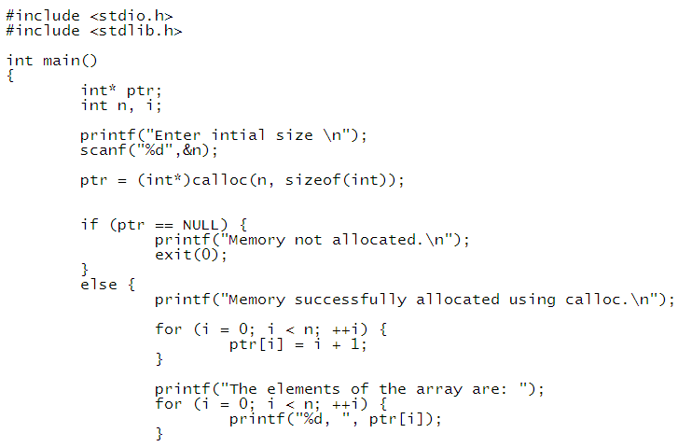
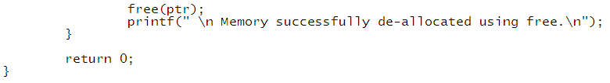

Slide 5
File: A file represents a sequence of bytes on disk where a group of related data is stored. File is created for permanent storage of data.
Types of Files: There are two types of Files.
1. Text Files : Consists of lines of characters
2. Binary Files: Binary Files stores floating point data.
There are different file organizations occurs in the file handling.
1. Sequential File access
2. Random Access Files

Slide 6
Sequential File Access: In this type, data are kept sequential. If we want to read the last record of the file, then we need to read all the records before the last record.
Random Access Files: In this type, data can be read and modified randomly. It takes less time as compared to sequential file.
File Operations in C
The processing of files has number of operations according to the user’s requirement. There are three file operations in C.
1. Opening File.
2. Reading/Writing data from/to File
3. Closing File.

Slide 7
Opening a File:
A File has to be opened before performing read and write operations. Opening a file creates a link between the operating system and the file functions. The name of the file and its mode to the operating system should be specifies one important task is carried out by the FILE structure that is defined in “stdio.h” header file.
Syntax for Opening file:
The fopen( ) function is used to create a new file or to open an existing file.
FILE *fp;
fp=fopen(filename,opening-mode);
Here
File name is the name of the file to be opened.
Mode specifies the purpose of opening the file.
*fp is the file pointer that contains address of the FILE.

Slide 8
Example: fp=fopen(“demo.txt”.”r”);
If the specified file is available fopen( ) returns address of the File otherwise it return NULL.

